Slide 1
Austin .NET User Group
April 10 2017
Austin TX

Slide 2
Upcoming Events - April
Holo Weekend Houston - 4/14/2017
https://www.facebook.com/events/1041790135927341
Feminist Hack Speed Peer Mentorship - 4/22/2017
https://www.meetup.com/Feminist-Hack-ATX/events/238683351/
Global Azure Bootcamp - 4/22/2017
https://global.azurebootcamp.net/locations/global-azure-bootcamp-2017-united-states-austin-tx/

Slide 3
Upcoming Events - May
VS Live Austin - 5/15/2017
$500 Off ticket - http://bit.ly/AUUG01home
Win a ticket
http://usergroup.tv/win-a-ticket-to-visual-studio-live
And at the end of the meeting
Keep Austin Agile - 5/25/2017
http://conference.agileaustin.org/

Slide 4
Caching in Microsoft Azure
Shawn Weisfeld
Sr. Technical Evangelist
Microsoft

Slide 5
Agenda
Do you need cache?
Where can you cache?
Cache-Aside Design Pattern
Caching in the Browser
Caching with a CDN
Caching on the Web Server
Caching with a Distributed Cache

Slide 6








About Me
Shawn Weisfeld
Sr. Technical Evangelist
Microsoft – US Developer Experience
sweisfel@microsoft.com
Austin, TX

Slide 7
Are you an ISV looking to utilize the cloud?
An ISV is a company that sells software or services powered by software.
My team wants to help you on your cloud journey!
Work with an Azure Architect to provide guidance on your technical journey to the cloud.
Work with a Business Evangelist to access Microsoft resources to help get exposure for your solution and bring your solution to market.
For more information email
USmicrosoftISVteam@microsoft.com
Watch recorded & live webcasts
http://www.buildandscaleyourcloudapp.com

Slide 8


Watch User Group presentations for FREE online! We now have over 590 presentations online
Miss a User Group meeting?
Forget something that you learned?
Want to see content from a User Group not in your area?
Want to share with a buddy?
Presentations from the thought leaders on the topics you care about including:
Agile
Azure
C#
Entity Framework
HTML5
MVC
SQL
jQuery
and Much More!
We know you cannot make it to every session,
that is why we post them online for you!
New Content added all the time!
For new content announcements
@UserGroupTV
http://www.UserGroup.tv

Slide 9
Do you need cache?

Slide 10

Source: https://www.bluedogposters.com.au/img/01/01-1104_l.jpg

Slide 11
Demo

Slide 12
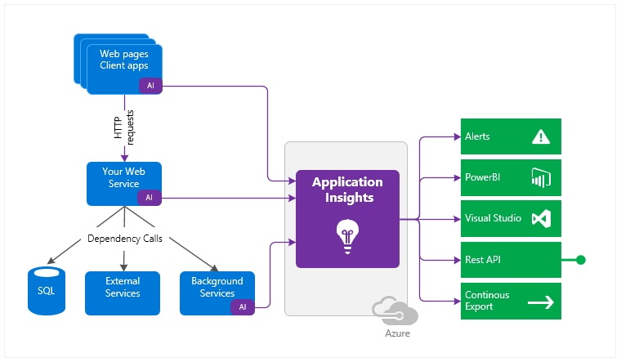
Application Insights

Slide 13
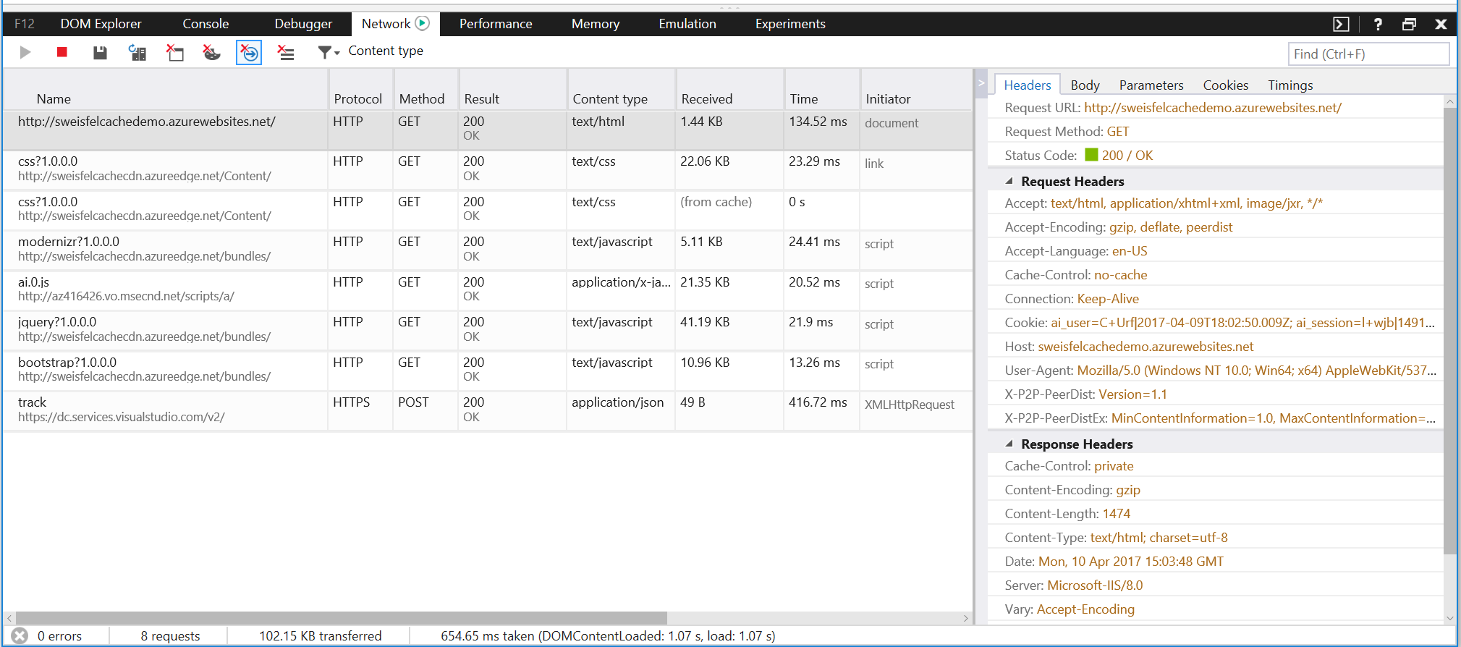
Browser Dev Tools

Slide 14
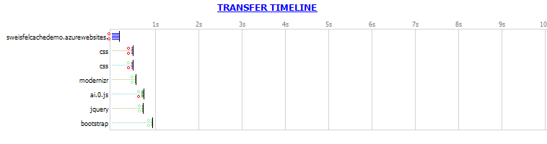
Fiddler & FiddlerCap
http://www.telerik.com/fiddler

Slide 15
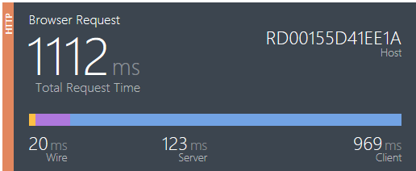
Glimpse
http://getglimpse.com

Slide 16
What are your favorite tools?

Slide 17
Where can you cache?

Slide 18
Typical Web Application
Data Store
Web Browser
Web Server

Slide 19
Cache in the browser
Data Store
Web Browser
Web Server

Slide 20
Caching with a CDN
Data Store
Web Browser
Web Server

Slide 21
Caching on the Web Server
Data Store
Web Browser
Web Server

Slide 22
Caching with a Distributed Cache
Data Store
Web Browser
Web Server

Slide 23
… not mutually exclusive
Data Store
Web Browser
Web Server

Slide 24
Cache-Aside Design Pattern

Slide 25
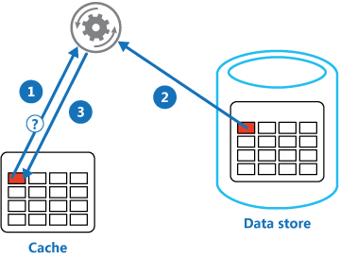
Cache-Aside Design Pattern
Is the item in the cache?
Yes, read the item from the cache, return to caller
No, get the item from data store, write it to the cache, return to caller
https://docs.microsoft.com/en-us/azure/architecture/patterns/cache-aside

Slide 26
Issues and considerations
Lifetime of cached data
Set exportation policy to evict stale data
Evicting data
When cache gets full older data is evicted
Priming the cache
Refresh cache with data you anticipate needing to reduce cache misses
Consistency
Update/Evict cache entries when data store changes
Local
Local caching vs. shared caching

Slide 27
Caching in the Browser

Slide 28
Cache in the browser
Data Store
Web Browser
Web Server

Slide 29
Demo

Slide 30
Cache-Control header
How & how long can the browser cache something
Client Side check

Slide 31
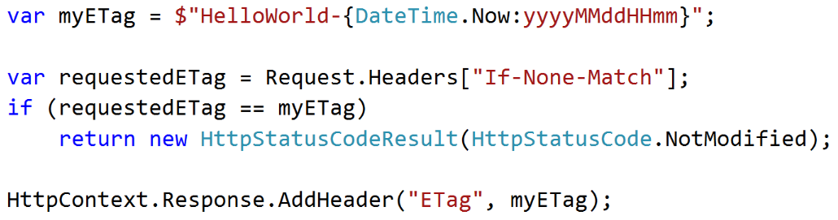
ETag header
Has the resource changed since last time
Round trip to server

Slide 32
NOTE: ASP.NET Helpers
OutputCache (Full Framework)
https://docs.microsoft.com/en-us/aspnet/mvc/overview/older-versions-1/controllers-and-routing/improving-performance-with-output-caching-cs
ResponseCache (.NET Core)
https://docs.microsoft.com/en-us/aspnet/core/performance/caching/response

Slide 33
Caching with a CDN

Slide 34
Caching with a CDN
Data Store
Web Browser
Web Server

Slide 35
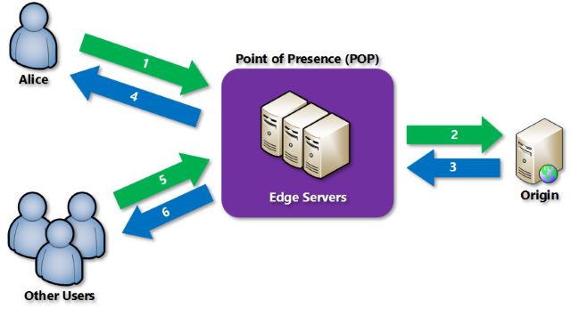
What is a CDN

Slide 36
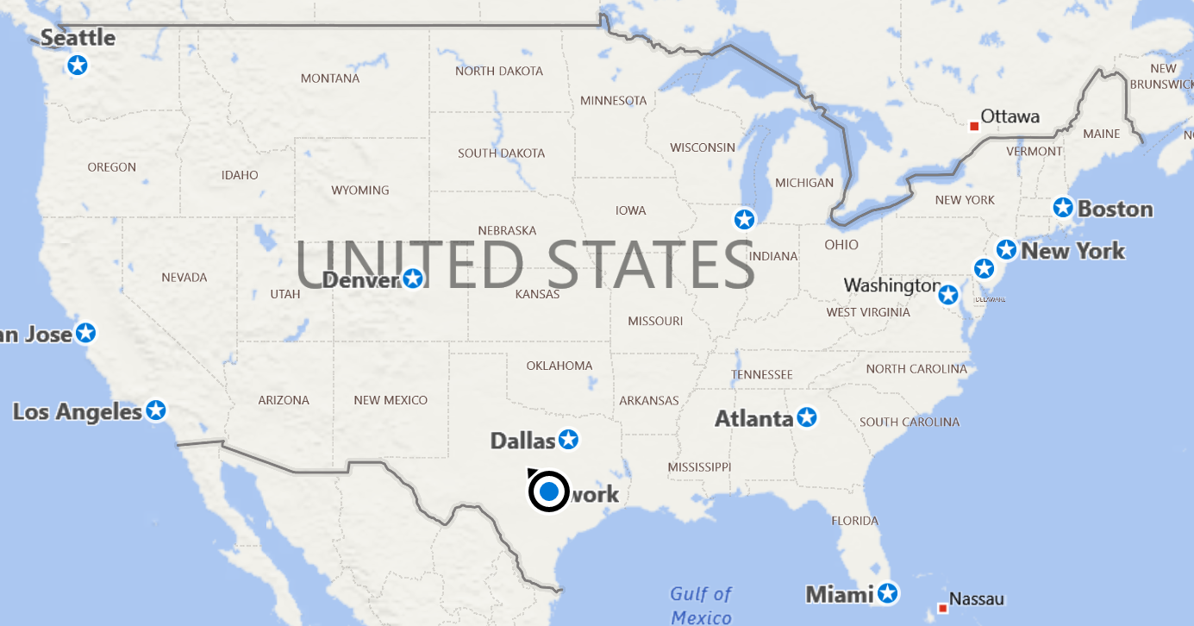

Slide 37
Demo

Slide 38
Caching on the Web Server

Slide 39
Caching on the Web Server
Data Store
Web Browser
Web Server

Slide 40
Demo

Slide 41
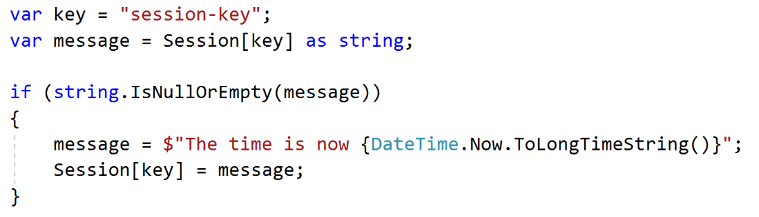
ASP.NET Session State

Slide 42
Scalability
Web Server
Data Store
Web Browser
Web Server

Slide 43
Caching with a Distributed Cache

Slide 44
Caching with a Distributed Cache
Data Store
Web Browser
Web Server

Slide 45
Demo

Slide 46
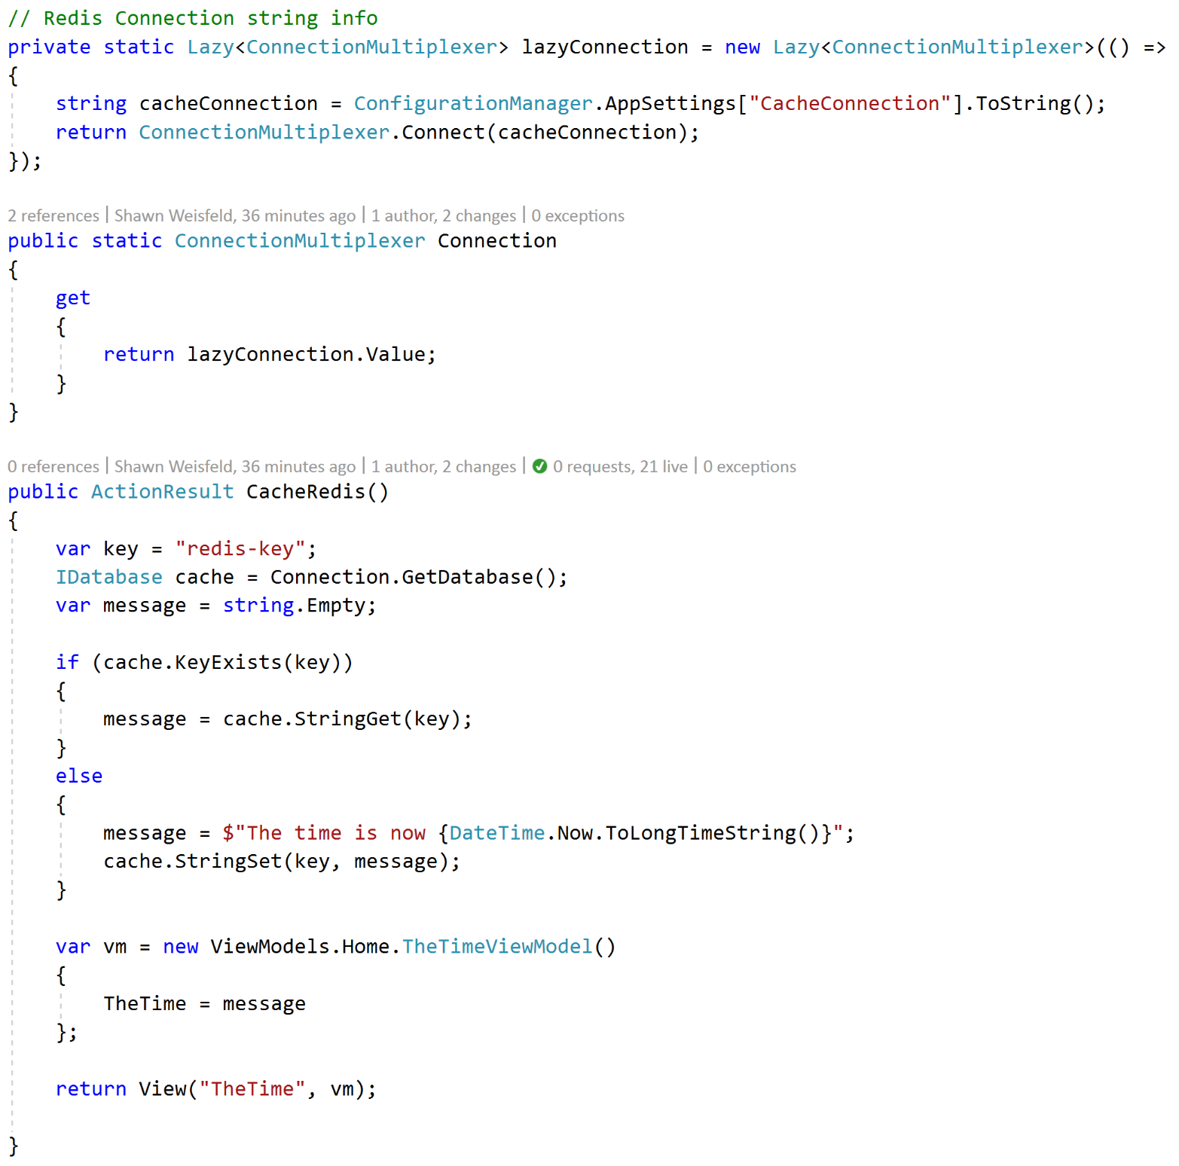
Redis Cache in Azure
https://docs.microsoft.com/en-us/azure/redis-cache/cache-web-app-howto

Slide 47
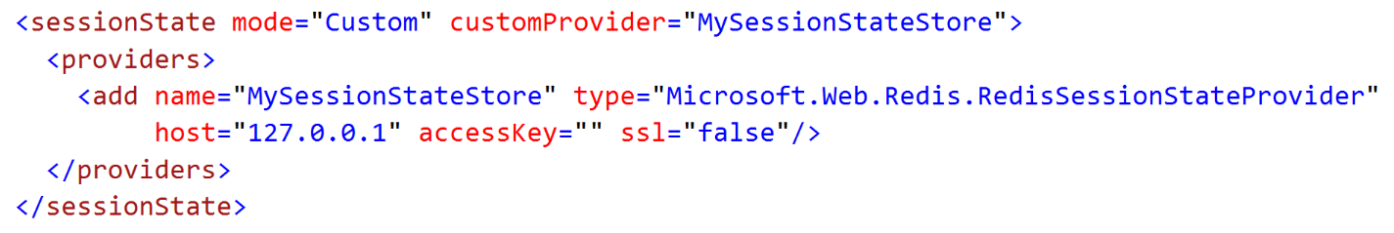
Using Redis with ASP.NET Session State
https://docs.microsoft.com/en-us/azure/redis-cache/cache-aspnet-session-state-provider

Slide 48
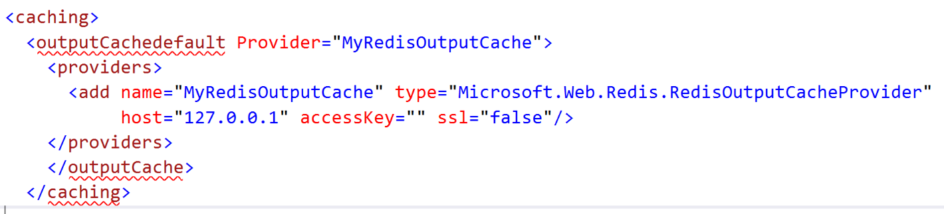
Using Redis with ASP.NET OutputCache
https://docs.microsoft.com/en-us/azure/redis-cache/cache-aspnet-output-cache-provider

Slide 49
Wrap up

Slide 50
Call to Action
Instrument your application
Evaluate Caching options in Azure
Apply generously where approperate

Slide 51
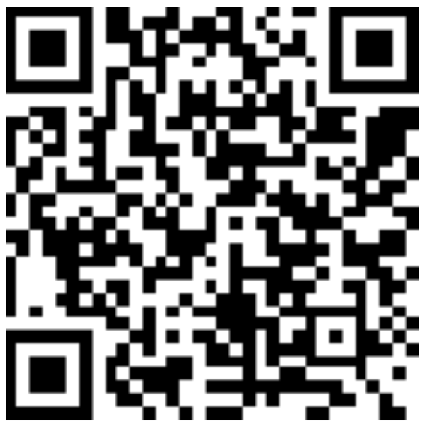
Thank you! Your Feedback is Important
Rate My Talk & Download Slides!
http://bit.ly/RateShawnsTalk
(case sensitive)
Contact Information
Email: sweisfel@microsoft.com
Blog: http://www.shawnweisfeld.com
Twitter: @shawnweisfeld

